Slide 1
PANIMALAR ENGINEERING COLLEGE
Department of Computer Science
AI based rectal cancer and stage prediction over web in real-time for general users
Team Members:
Boggada Mounika 211418104041
Y. Eesha Sai Sri 211418104057
Pancheti Divija Reddy 211418104184
Guide:
DR. K. Sangeetha
Designation:
Associate Professor
1

Slide 2
INTRODUCTION
With the development of targeted therapies, many treatments are based on molecular studies, which require sampling tumour tissue from paraffin blocks for sequencing.
An automated solution could potentially reduce the workload of pathologists by acting as a screening device and may reduce the subjectivity in diagnosis. In tissue-based diagnostics, most of the work still needs to be done manually by a pathologist using a microscope to examine stained slides.
The foundation of such tasks is to accurately distinguish cancer/malignant cells from normal/benign cells. However, the determination of tumour content is poorly reproducible with significant variation.
As the size of tumour regions can be very small, pathologists are often required to use high magnification for detecting tumour cells. This requirement significantly increases the workload for pathologists.
As digital pathology datasets have become publicly available and have opened up the possibility of evaluating the feasibility of applying deep learning techniques to improving the efficiency and quality of histologic diagnosis.
In this project we introduce an application to detect Rectal cancer based on Convolutional Neural Network and Ranking algorithm.

Slide 3
LITERATURE SURVEY
AUTHOR | METHODOLOGY | MAJOR FINDINGS
Ling Zheng, Elijah Eniola, Jiacun Wang (2021) | All the eight machine learning algorithms are used for training and testing are for training and testing. | These model is used to predict the risk of colorectal cancer using machine learning.
Pallavi Sharma, Kangana bora, Kunio Kasugai and Sunil Kumar balabantaray (2020) | CNN (Convolutional Neural Network) | These model is used to deduct the colorectal cancer with two states classification.
Ballesteros, Trujillo and C. Mazo (2020) | SVM (Support Vector Machine) | These model is used to find the classification of non-informative frames.
G.W. boers, J.van der putten, J.de groof, M.struyvenberg, K.fockens, W.curvers, E.schoon, F.van der sommen, J.bergman and P.H.N.de (2020) | Machine Learning- LSTM (Long Short Term Memory), GRU ( Gated Recurrent Units) and RNN (Recurrent Neural Networks. | These model is used for deduction of informativeness frames in endo-scopic videos.
A.B.M.R.Isla, A.Alammari, W.Tavanapong,J.wong and P.C.de groen (2019) | CNN (Convolutional Neural Network) | These model is used for finding classification of non-informative frames.

Slide 4
PROBLEM STATEMENT
Colorectal cancer is also known as colon cancer, bowel cancer or colorectal adenocarcinoma. The main negative aspect of cancer is its diagnosis and treatment too late.
Due to this problem, cancer has overtaken heart disease as the leading cause of death for any age on. Therefore, early detection of cancer is important. With the development of targeted therapies, many treatments are based on molecular studies, which require sampling tumor tissue from paraffin blocks for sequencing.
An automated solution could potentially reduce the workload of pathologists by acting as a screening device and may reduce the subjectivity in diagnosis.
As datasets have become publicly available and have opened up the possibility of evaluating the feasibility of applying deep learning techniques to improving the efficiency and quality of histologic diagnosis.
In this project we introduce an application to detect Rectal cancer based on Convolutional Neural Network and Ranking algorithm.

Slide 5
DEVELOPMENT ENVIRONMENT
HARDWARE ENVIRONMENT:
Processor - Pentium –IV
Speed - 1.1 Ghz
RAM - 4GB RAM
Hard Disk - 20 GB
Key Board - Standard Windows
Mouse - Two or Three Button Mouse
Monitor - ANY
SOFTWARE ENVIRONMENT:
Operating System – Unix/Linux/XP/7/8/8.1/10
Coding Language – Python >= 3.8.0
Flask

Slide 6
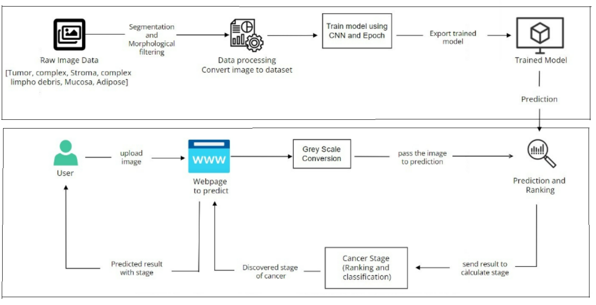
SYSTEM ARCHITECTURE

Slide 7
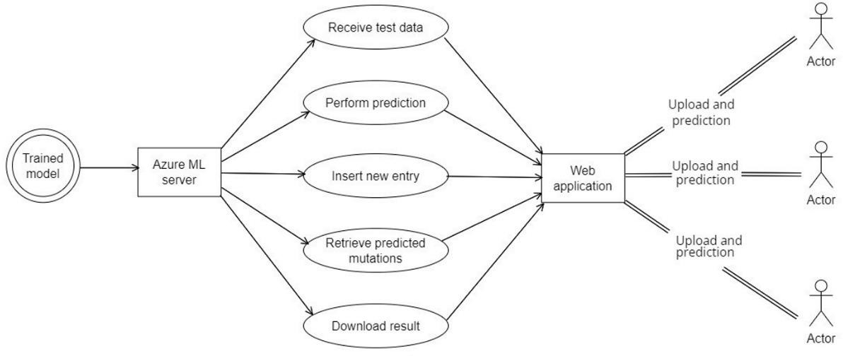
SYSTEM DESIGN - UML DIAGRAM

Slide 8
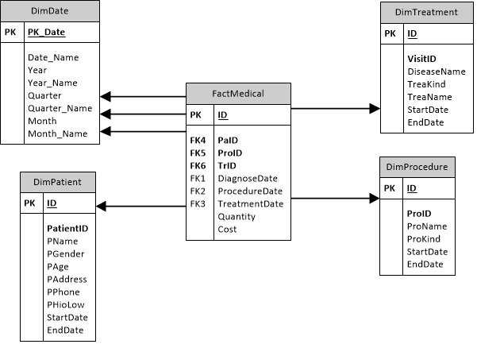
DATABASE DIAGRAM

Slide 9
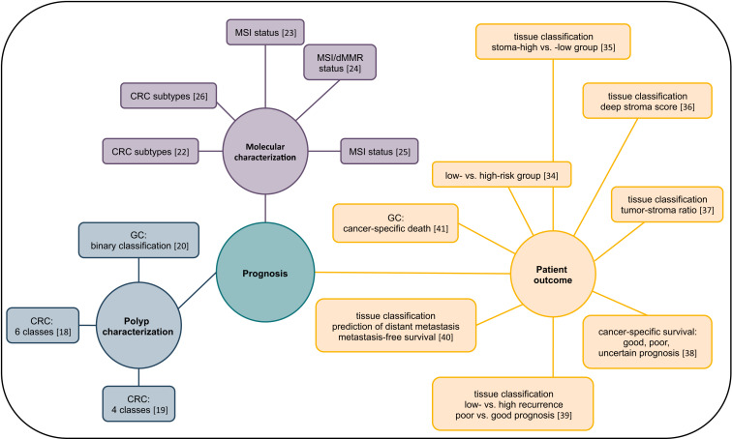
ER DIAGRAM

Slide 10
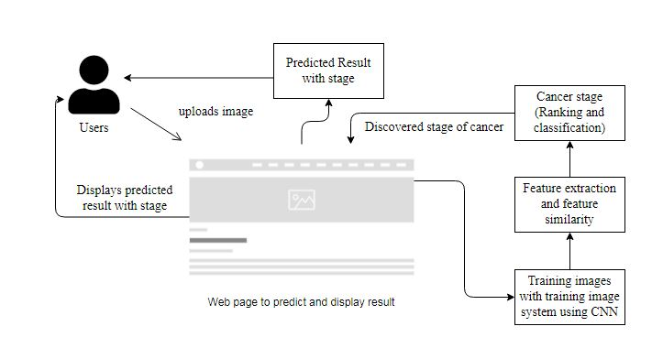
INPUT DESGIN(UI)

Slide 11
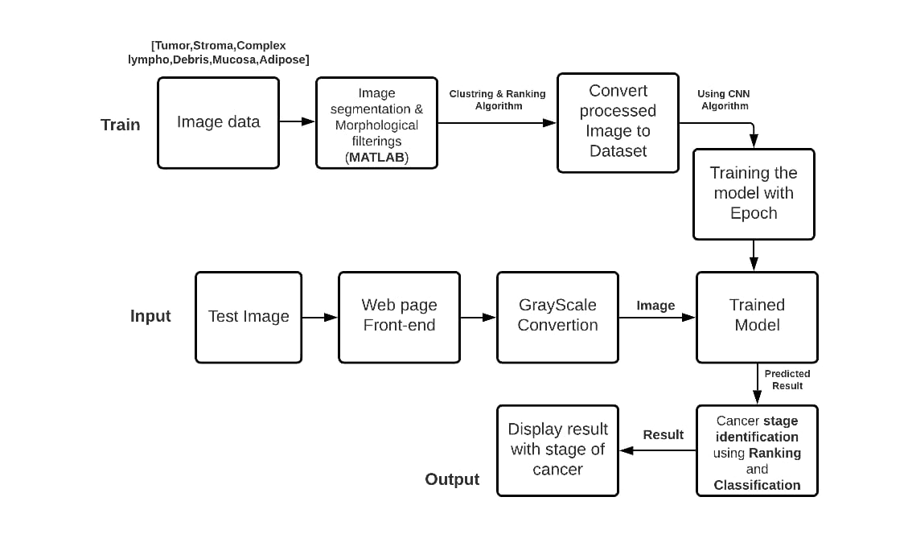
DATAFLOW DIAGRAM

Slide 12
MODULE DESCRIPTION
Dataset preparation and pre-processing
Dataset splitting
Modelling
Model deployment over web
Dataset preparation and preprocessing:
Data is the foundation for any machine learning project. The second stage of project implementation is complex and involves data collection, selection, preprocessing, and transformation which includes:
i. Data collection :
https://zenodo.org/record/53169#.Yb8SEtvhXEp
Tumor
Stroma
Complex

Slide 13
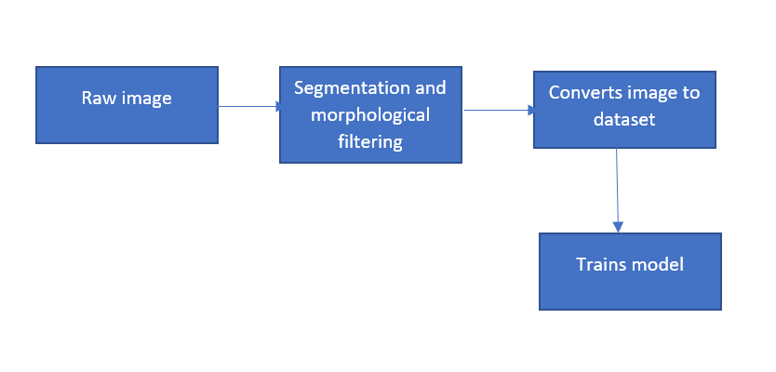
MODULE DESCRIPTION
Data preprocessing:
Here the collected tissues are given as raw data set to train the model for prediction. After conversion the images undergo image segmentation, which involves converting an image into a collection of regions of pixels that are represented by a mask or a labeled image. By dividing an image into segments, you can process only the important segments of the image instead of processing the entire image.

Slide 14
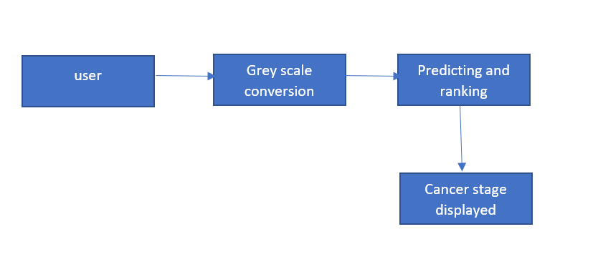
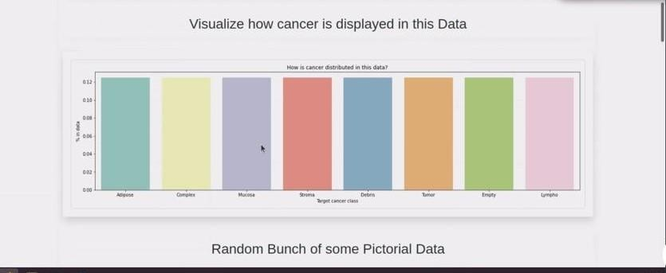
MODULE DESCRIPTION
Data transformation:
After training the data user has to select the image for the prediction using CNN algorithm.
Data visualization:
Here the data is represented the chart as we splits the types of cancer in the form of distributed data.

Slide 15
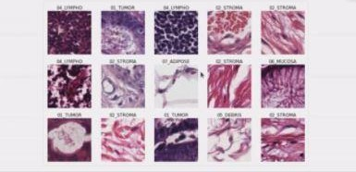
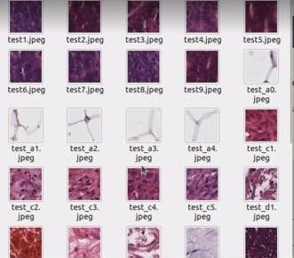
MODULE DESCRIPTION
Data splitting:
i) Training set :
A data scientist uses a training set to train a model and
define it optimal parameters-parameters it has to learn from data.
Test set:
A test set is needed for an evaluation of the trained
model and its capability for generalization.

Slide 16
MODULE DESCRIPTION
Modelling:
During this stage we train numerous models to define which one of them provides the most accurate prediction.
i)Model training:
Here the human tissues collected from the lab/hospitals are to be drained and converted to datasets.

Slide 17
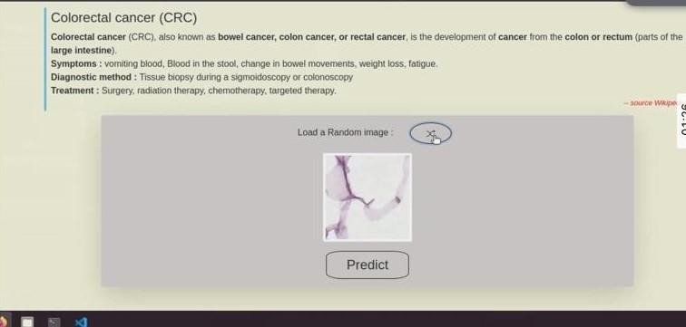
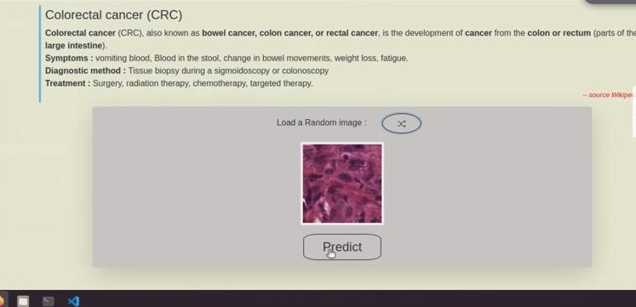
MODULE DESCRIPTION
Model evaluation and testing:
This process is done by the user as the trained images are available and need to be selected and the stage of the cancer is predicted. This is done in the web page.
Model deployment over web:
After selecting the image by the result as the cancer prediction and ranking is done over the web.

Slide 18
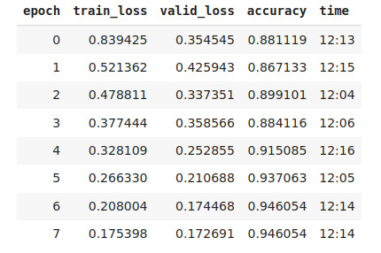
RESULT
Using 7 epochs we are getting is 94% accuracy.

Slide 19
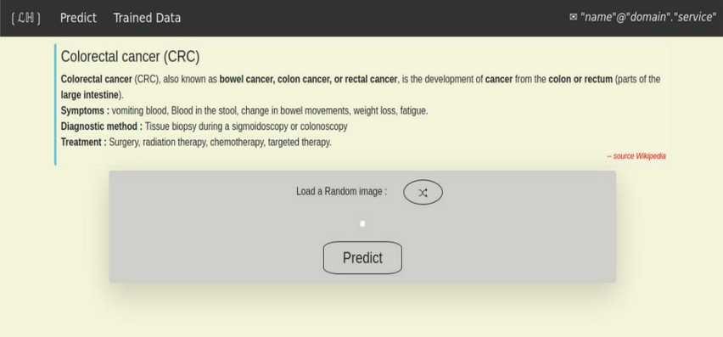
SCREEN SHOTS
Select the image

Slide 20
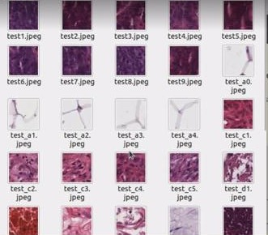
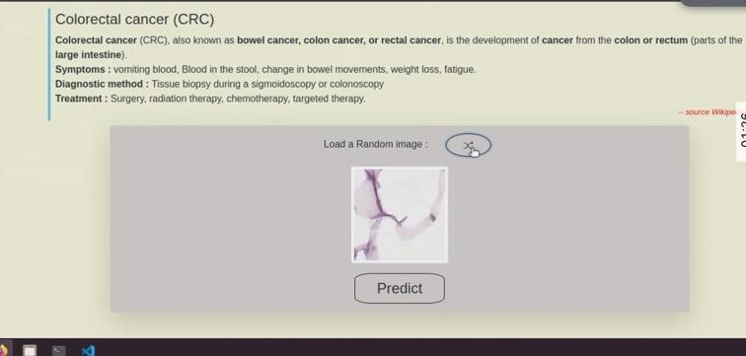
Trained data
Uploading the image

Slide 21
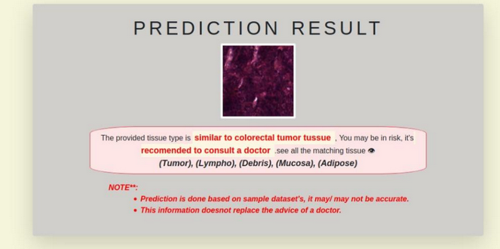
Result more chance of colorectal cancer

Slide 22
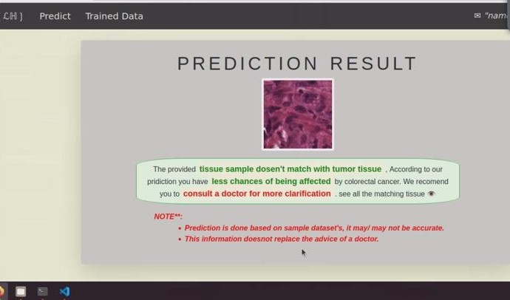
Result with less chance of colorectal cancer

Slide 23
CONCLUSION
Early detection of cancer is very important in the medical field. In this work,we present an image-based feature extraction, segmentation and training approaches for classification and screening of cancer tissues.
The previous work focused on k-mean clustering which is less efficient and accuracy was 73%. In our work we have increased the accuracy to 94% by training the model with EPOCH.
LSTM is used for fast processing and stores the best result for comparison in the future. Analysis is done by training a Neural network using the processed set of images in predicting the future output from input given to model.
Future works Will Be Directed Towards Analysis of additional data sets acquired under controlled imaging conditions.
Since the datasets under analysis in this work represent a huge variety of imaging condition variabilities, the observations from the experimental analysis are more generalizable yet limited in classification capabilities.

Slide 24
REFERENCE
[1]. Bunil Kumar Balabantaray,Kangkana Bora, Kunio Kasugai and Pallabi Sharma(2020) “Two Stage Classification With CNN For Colorectal Cancer Detection”Oncologie (SCI)
[2]. M. Jayakandan, T. Manivannan(February 2018) “Colorectal Cancer Detection in MRI Images Using Image Processing Techniques”International Journal of Engineering Science & Research Technology
[3].Jiri Prinosil,Malay Kishore Dutta, Namita Sengar, Neeraj Mishra, Radim Burget(2016)“Grading Of Colorectal Cancer Using Histology Images” 39th International Conference on Telecommunications and Signal Processing,29 June 2016
[4].KorsukSirinukunwattana et al.,(2016)“Locality Sensitive Deep Learning for Detection and Classification ofNuclei in Routine Colon Cancer Histology Images”,IEEE Transactions on Medical Imaging(Volume:35, Issue: 5)
[5]Shi, G., Wang, Y., Zhang, C., Zhao, Z., Sun, X., Zhang, S., … Liu, J. (2018). Identification of genes involve in the four stages of colorectal cancer: Gene expression profiling. Molecular and Cellular Probes 37, 39-47. https://doi.org/10.1016/j.mcp.2017.11.004

Slide 25
PLAGIARISM REPORT

